Slide 1

Johnston Lab Meeting:
Temporal Activation and Repression of Spineless Mutants
Josh Derrick 2.11.2021

Slide 2
Outline
1. Recap fly eye development and the role of spineless
2. Breaking spineless: Exc154 deletion
3. Conclusions and Future Directions

Slide 3
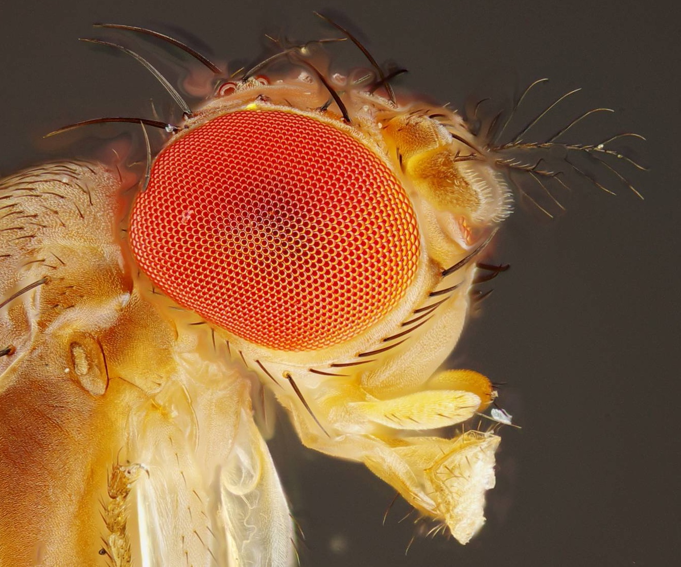
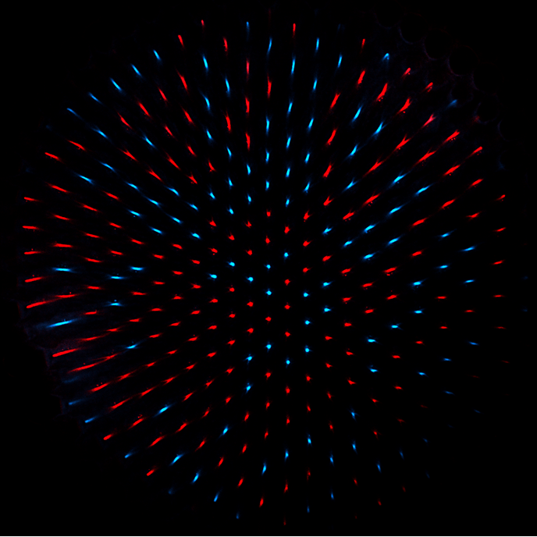
Rhodopsins are expressed stochastically in the fly retina
Rh4
Rh3

Slide 4
Spineless regulates Rhodopsin expression in R7 cells
Spineless
Spineless
Rh3
Rh4
Rh3
Rh4
Wernet et al., 2006
Johnston and Desplan, 2014
Notes:
This binary decision is controlled by the transcription factor spineless. R7 cells expressing spineless take on the Rh4 fate, while R7 cells lacking spineless take on the RH3 Fate.
such that the presence of spineless drive expression of rh4 and the absence drives rh3 state, giving us a mosaic patter in the adult retina in which 67 percent of R7 cells express spineless and rh4. Understanding the stochastic expression of spineless has been a focus of the lab.
Spineless is randomly expressed in 67% of R7 cells. In the presence of spineless, this drives the Rh4 expression state, while in the absence of spineless we will see Rh3 expression as seen here. So for the rest of my talk I want to point out that the as we can see here we can directly quantify spineless, but more commenly the way the lab assesses spineless expression in the eye is instead by looking at Rh4 vs. Rh3 expression in the retina, so for the data I am going to tell you about I am looking at the percent of R7 cells that express Rh4 as an output of spineless expression.

Slide 5
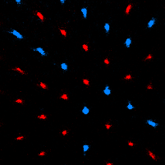
Spineless regulates Rhodopsin expression in R7 cells
Spineless
Spineless
Rh3
Rh4
Rh3
Rh4
67% Ss/Rh4
Wernet et al., 2006
Johnston and Desplan, 2014
Notes:
Resulting in a mosaic pattern in the adult retina where 67 percent of R7 cells express spineless and RH4.
Spineless is randomly expressed in 67% of R7 cells. In the presence of spineless, this drives the Rh4 expression state, while in the absence of spineless we will see Rh3 expression as seen here. So for the rest of my talk I want to point out that the as we can see here we can directly quantify spineless, but more commenly the way the lab assesses spineless expression in the eye is instead by looking at Rh4 vs. Rh3 expression in the retina, so for the data I am going to tell you about I am looking at the percent of R7 cells that express Rh4 as an output of spineless expression.

Slide 6
Eye
Antenna
ss RNA
Notes:
Antenna and eye in one continuous tissue. It is at this stage that photoreceptors are terminally differentiated in the eye. If we look at spineless expression at this time, we see broad expression in the antenna. The eye has a more complicated pattern of expression. Early in the larval stage, all cells of the eye are in an undifferentiated state

Slide 7
Eye
Antenna
Undifferentiated
ss RNA
Notes:
Here I have highlighted a specific region

Slide 8
Eye
MF
Antenna
Undifferentiated
MF
ss RNA
Notes:
Moves anteriorly.

Slide 9
Eye
MF
R7
Precursors
Antenna
Undifferentiated
MF
ss RNA

Slide 10
Eye
MF
R7
Precursors
Antenna
Undifferentiated
MF
ss RNA
Notes:
Cells posterior to this furrow experience a pulse of ss expression, and we will call them R7 precursors

Slide 11
Eye
MF
R7
Precursors
Antenna
Undiff
Diff
MF
ss RNA
Notes:
Following this brief pulse, ss expression ceases and the cells continue to differentiate

Slide 12
Eye
MF
R7
Precursors
Antenna
Differentiating
MF
ss RNA

Slide 13
Eye
MF
R7
Precursors
Antenna
Differentiating
MF
ss RNA

Slide 14
Eye
R7
Precursors
Antenna
Differentiating
MF
ss RNA

Slide 15
Eye
Terminal R7s
Antenna
Differentiating
MF
ss RNA

Slide 16
Eye
Terminal R7s
Antenna
Differentiating
MF
ss RNA
Notes:
After a number of hours have passed, these cells reach their terminal cell fate, decide to either maintain their ss of state or reinitiate ss expression.

Slide 17
Eye
Terminal R7s
Antenna
Differentiating
MF
ss RNA

Slide 18
Eye
Terminal R7s
Antenna
Diff
MF
ss RNA
Notes:
And here is where we begin to see the 67% on off ratio seen in adults

Slide 19
Undiff
Dif
Antenna
MF
Terminal
R7 Precursors
ss RNA
Notes:
Because the eye develops in this way, we can get multiple stages or R7 development within a single eye antennal disk. Cells prior to the furrow remain undifferentiated. Cells at the furrow, expressing spineless are R7 precursors and at the onset of differentiating, and cells at the posterior end have reached their terminal state

Slide 20
Undiff
Dif
Antenna
MF
Terminal
R7 Precursors
ss RNA
Notes:
Here is a tiled RNA FISH image where this pattern of expression is clearly illustrated. So cells in this region will be undifferentiated, cells here expressing are at the precursor stage. Then these at the posterior end are in their terminal state and either on or off

Slide 21
Outline
1. Recap fly eye development and the role of spineless
2. Breaking spineless: Exc154 deletion
3. Conclusions and Future directions

Slide 22
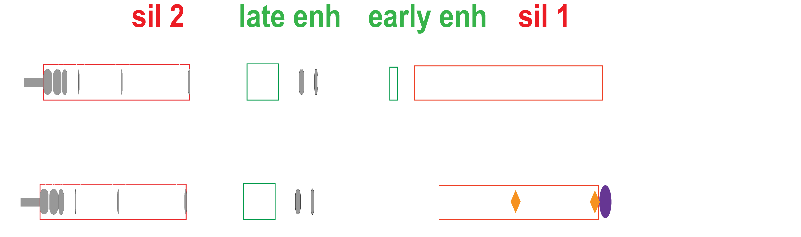
Spineless Architecture

Slide 23
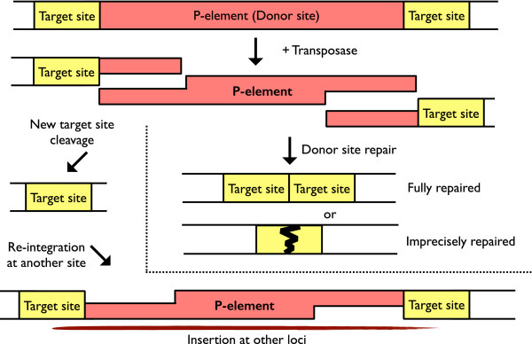
P-Site mutagenesis: Breaking Spineless Architecture
Thanks to Bob and Adrienne Chen for generating the mutation/the genomic prep
Shih-Ching Lin, 2014h

Slide 24
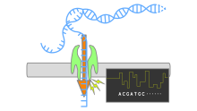
Verifying Exc154 Genotype
1. Nanopore

Slide 25
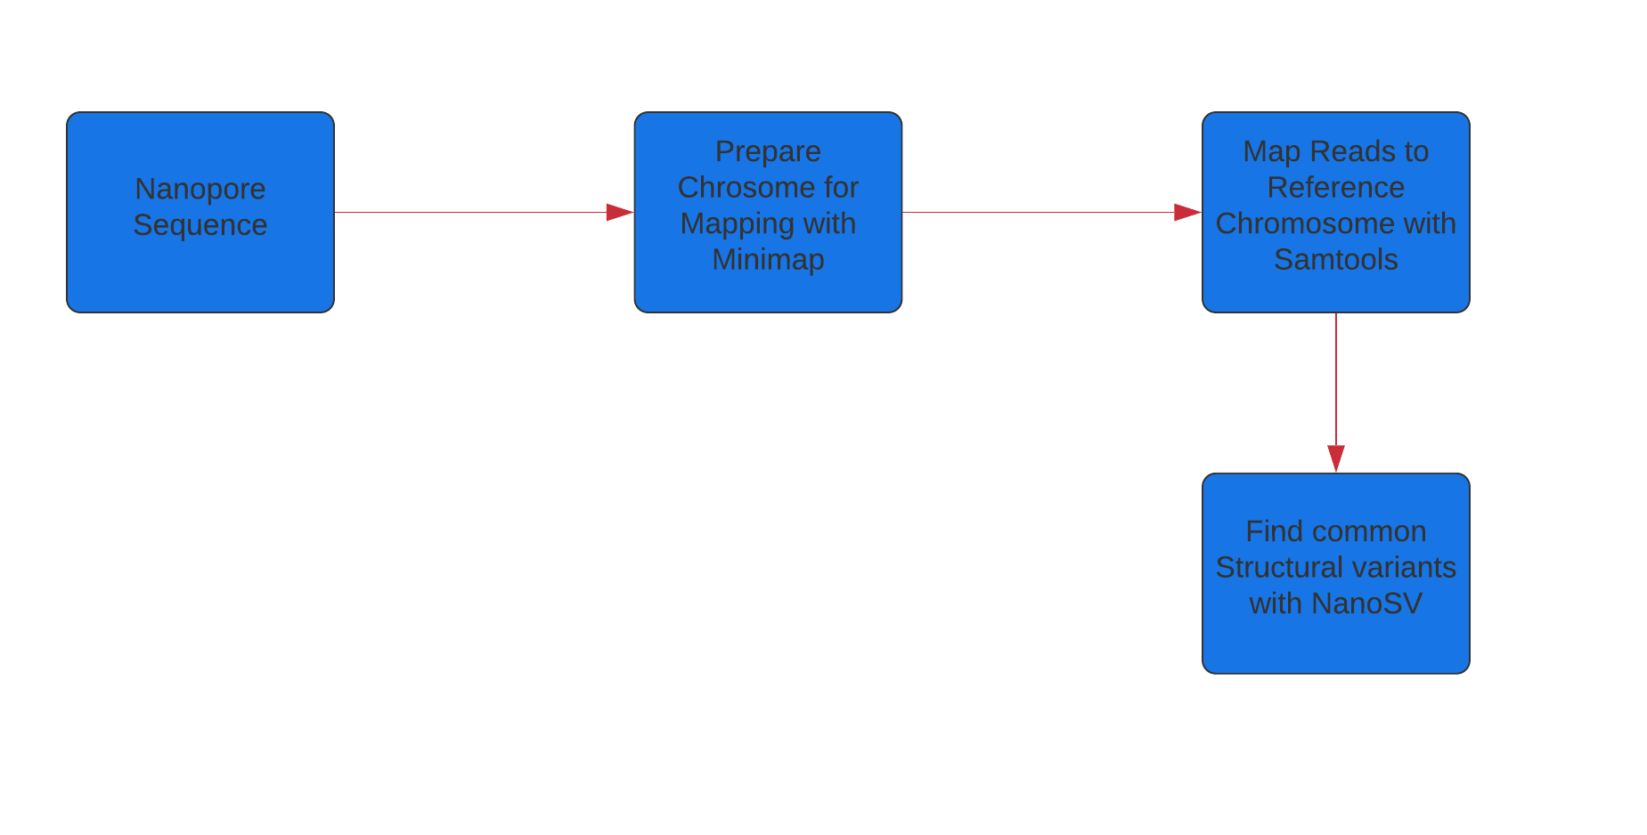
Verifying Exc154 Genotype
1. Nanopore
1a. Processing Nanopore
Code Availability: https://github.com/ATiredVegan/Johnston_lab

Slide 26
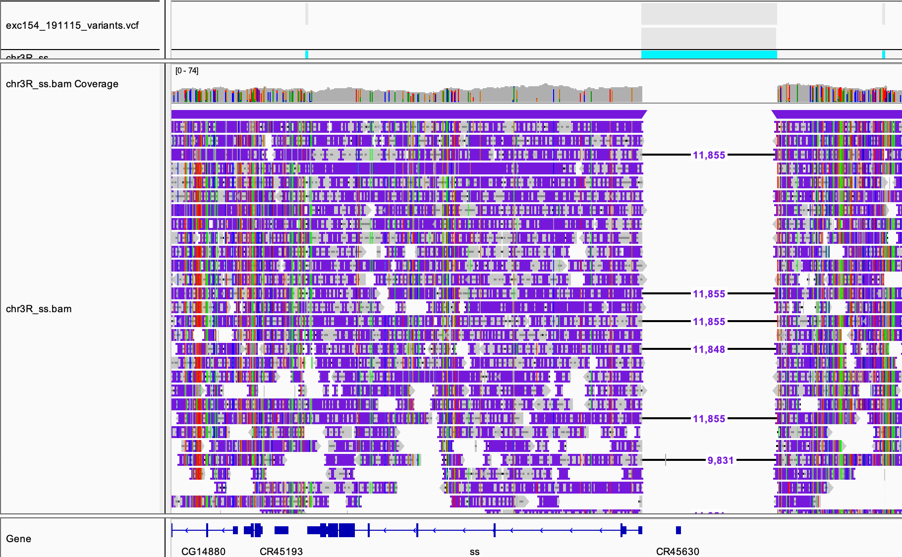
Verifying Exc154 Genotype
1. Nanopore
2. Variant call to find structural Variants

Slide 27
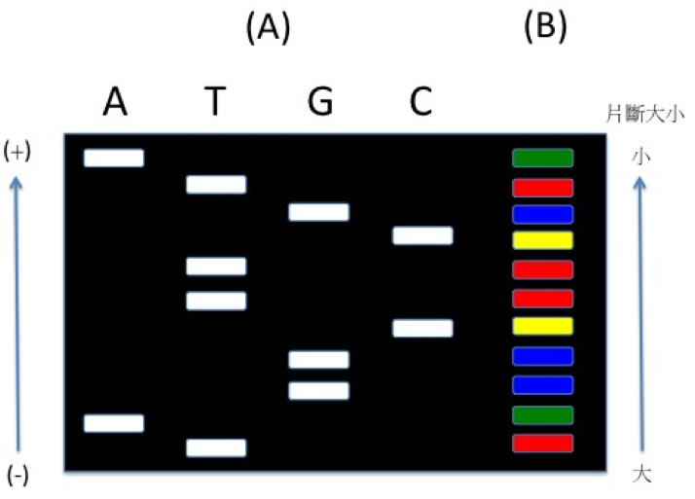
Verifying Exc154 Genotype
1. Nanopore
2. Variant call to find SVs
3. Sanger Sequencing for breakpoints

Slide 28
Spineless Architecture

Slide 29
Verifying Adult Rh3 Phenotype
WT
~61% Rh4/ss

Slide 30
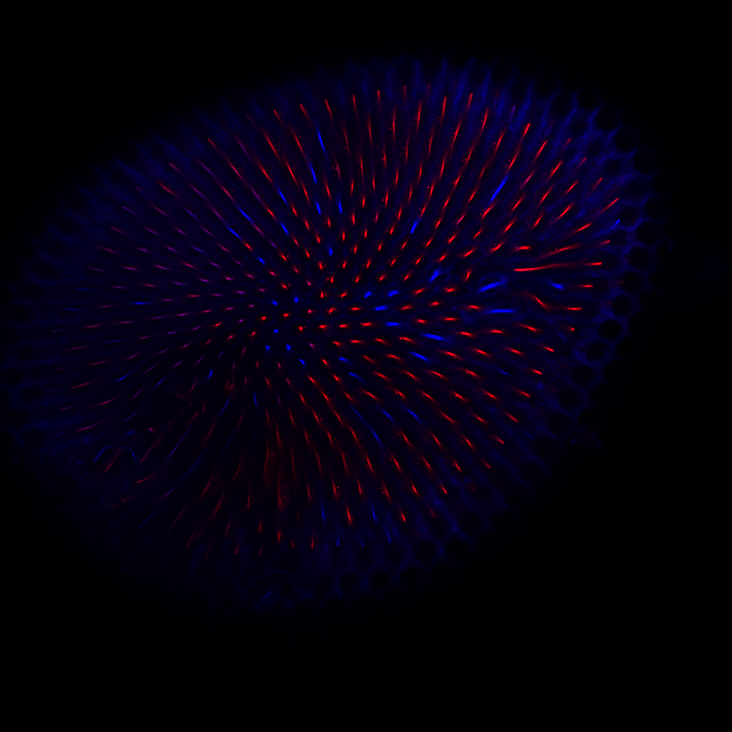
Verifying Adult Rh3 Phenotype
WT
~61% Rh4/ss
Exc154/def
~85% Rh4/ss

Slide 31
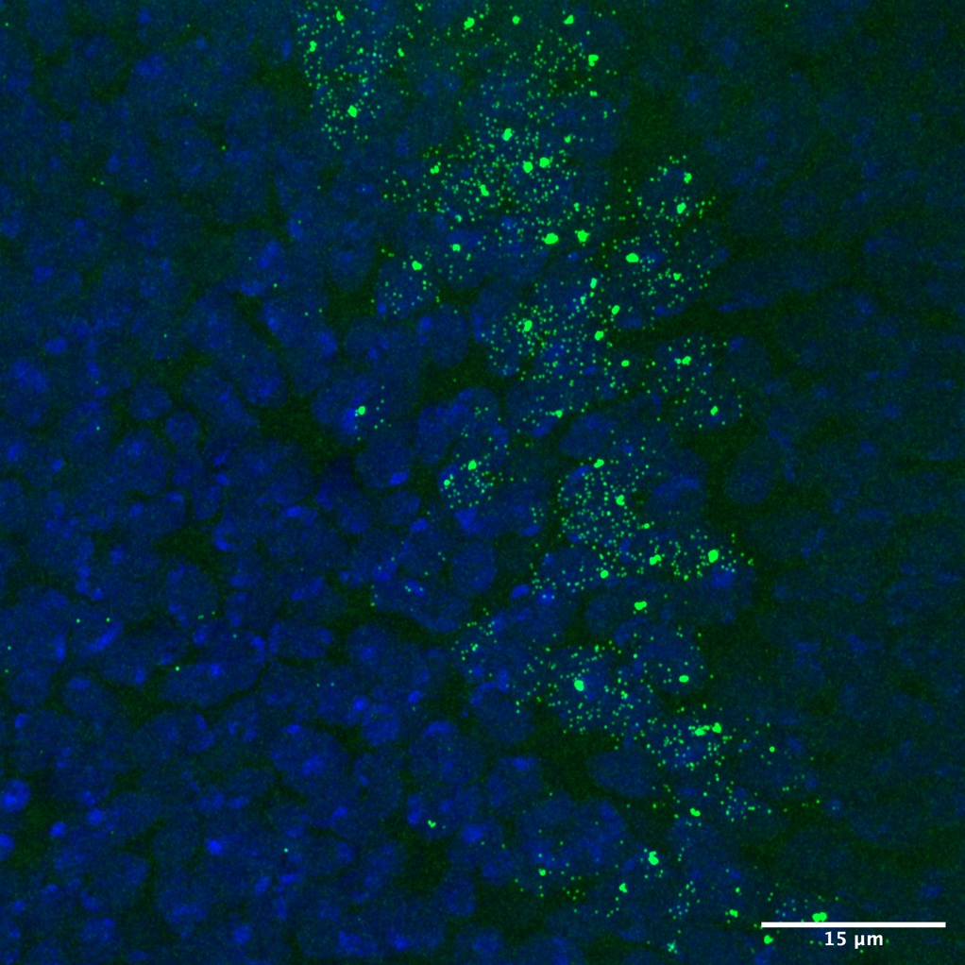
What happens to spineless expression early?
In WT there is an early pulse of spineless
Since Exc154 does not have the early enhancer, we should see no early pulse
Antennal expression as a control

Slide 32
RNA-FISH: Wildtype
DAPI+
ssRNA
ssRNA
Antenna

Slide 33
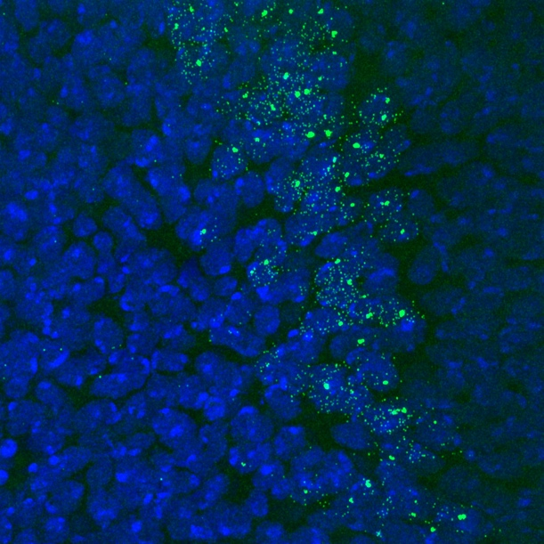
RNA-FISH: Wildtype
DAPI+
ssRNA
ssRNA
Antenna
Pulse

Slide 34
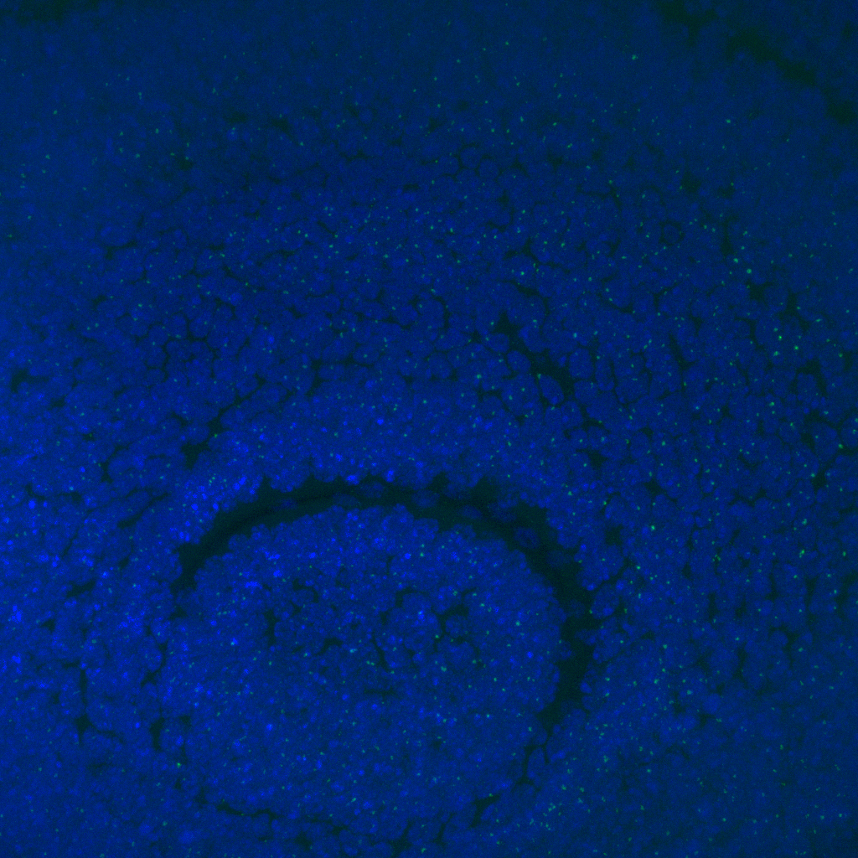
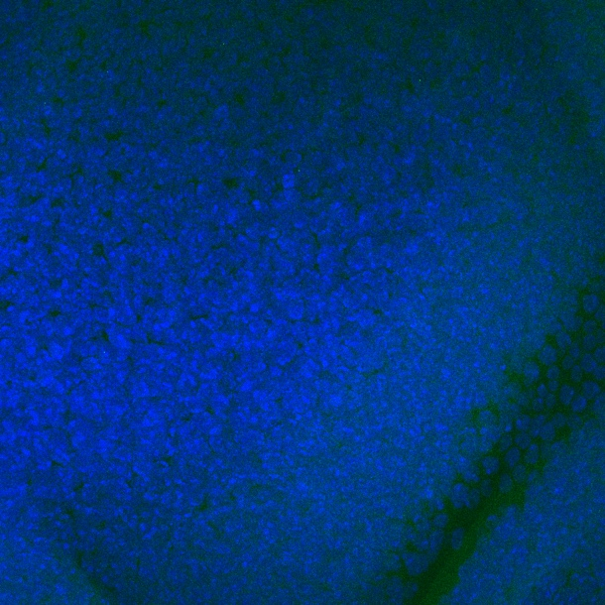

RNA-FISH: Exc154/def
DAPI+
ssRNA
ssRNA
Antenna
Pulse

Slide 35


RNA-FISH: Exc154/def
DAPI+
ssRNA
ssRNA
Antenna
Pulse

Slide 36

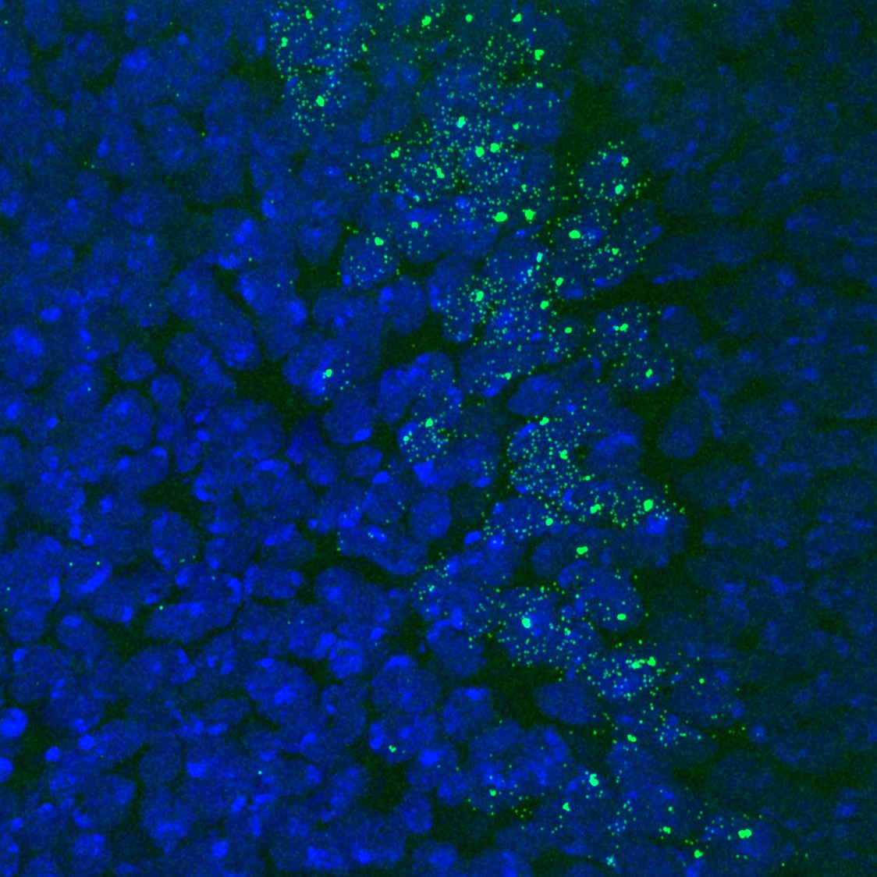
No Early Pulse in the Hemi
WT Pulse
Exc154/def Pulse

Slide 37

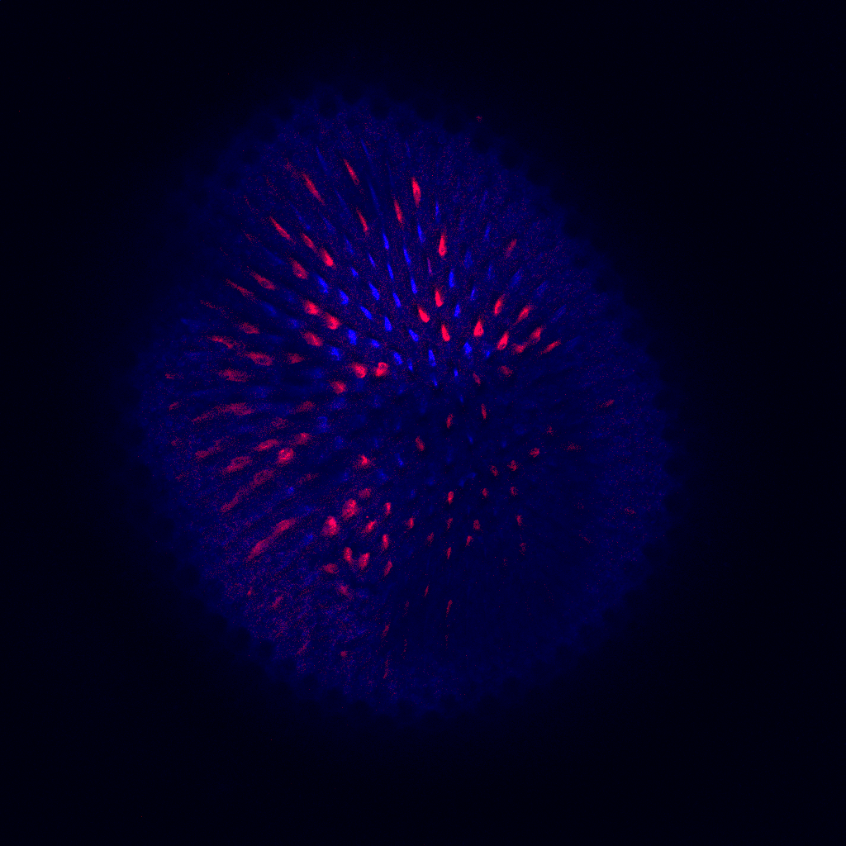
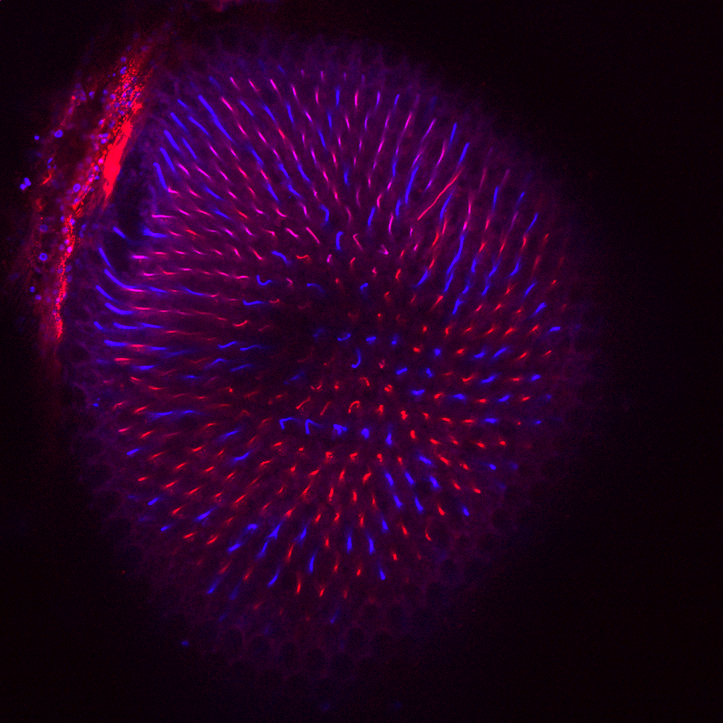
What about the homozygote?
WT
~61% Rh4/ss
Exc154/null
~85% Rh4/ss
Exc154/
~25% Rh4/ss

Slide 38
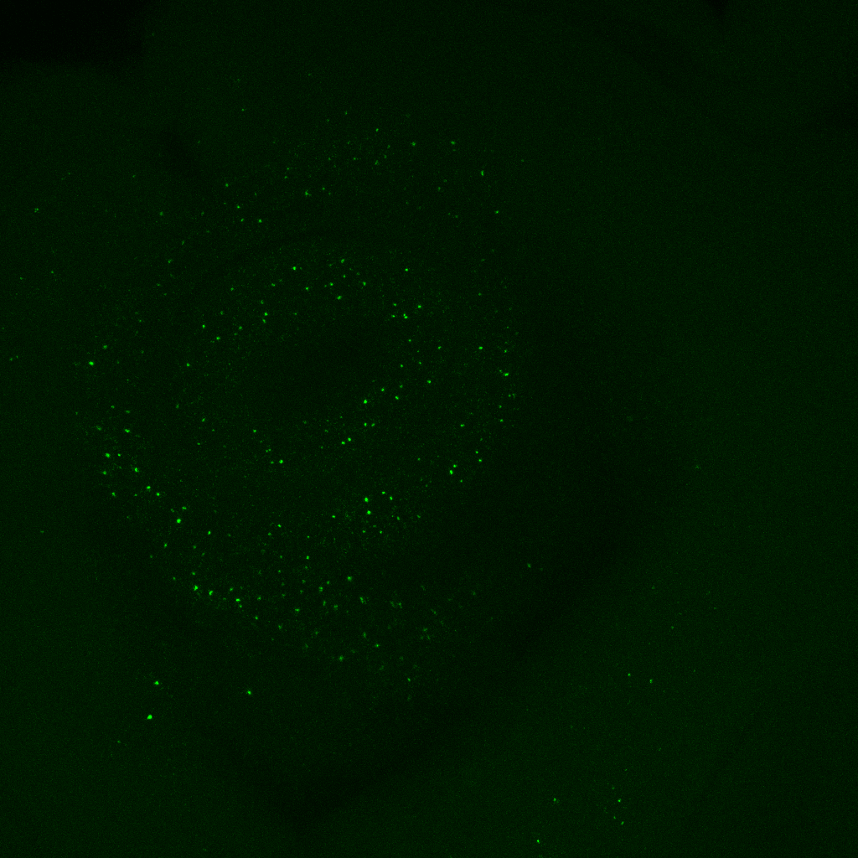
SC RNA-FISH: Exc154/Exc154
DAPI+
ssRNA
ssRNA
Antenna

Slide 39
SC RNA-FISH: Exc154/Exc154
DAPI+
ssRNA
ssRNA
Antenna
Pulse+Terminals

Slide 40
SC RNA-FISH: Exc154/Exc154
DAPI+
ssRNA
ssRNA
Antenna
Pulse+Terminals

Slide 41

It’s not the early pulse
Exc154/Def Pulse
Exc154/Exc154 Pulse

Slide 42
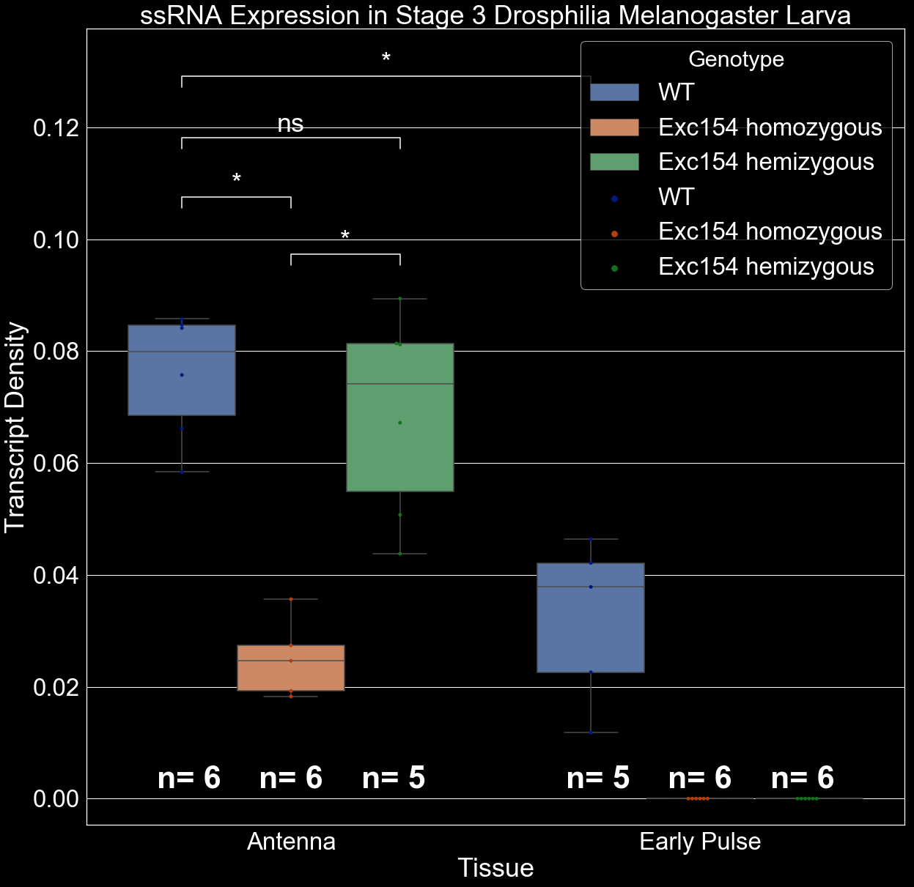

Slide 43
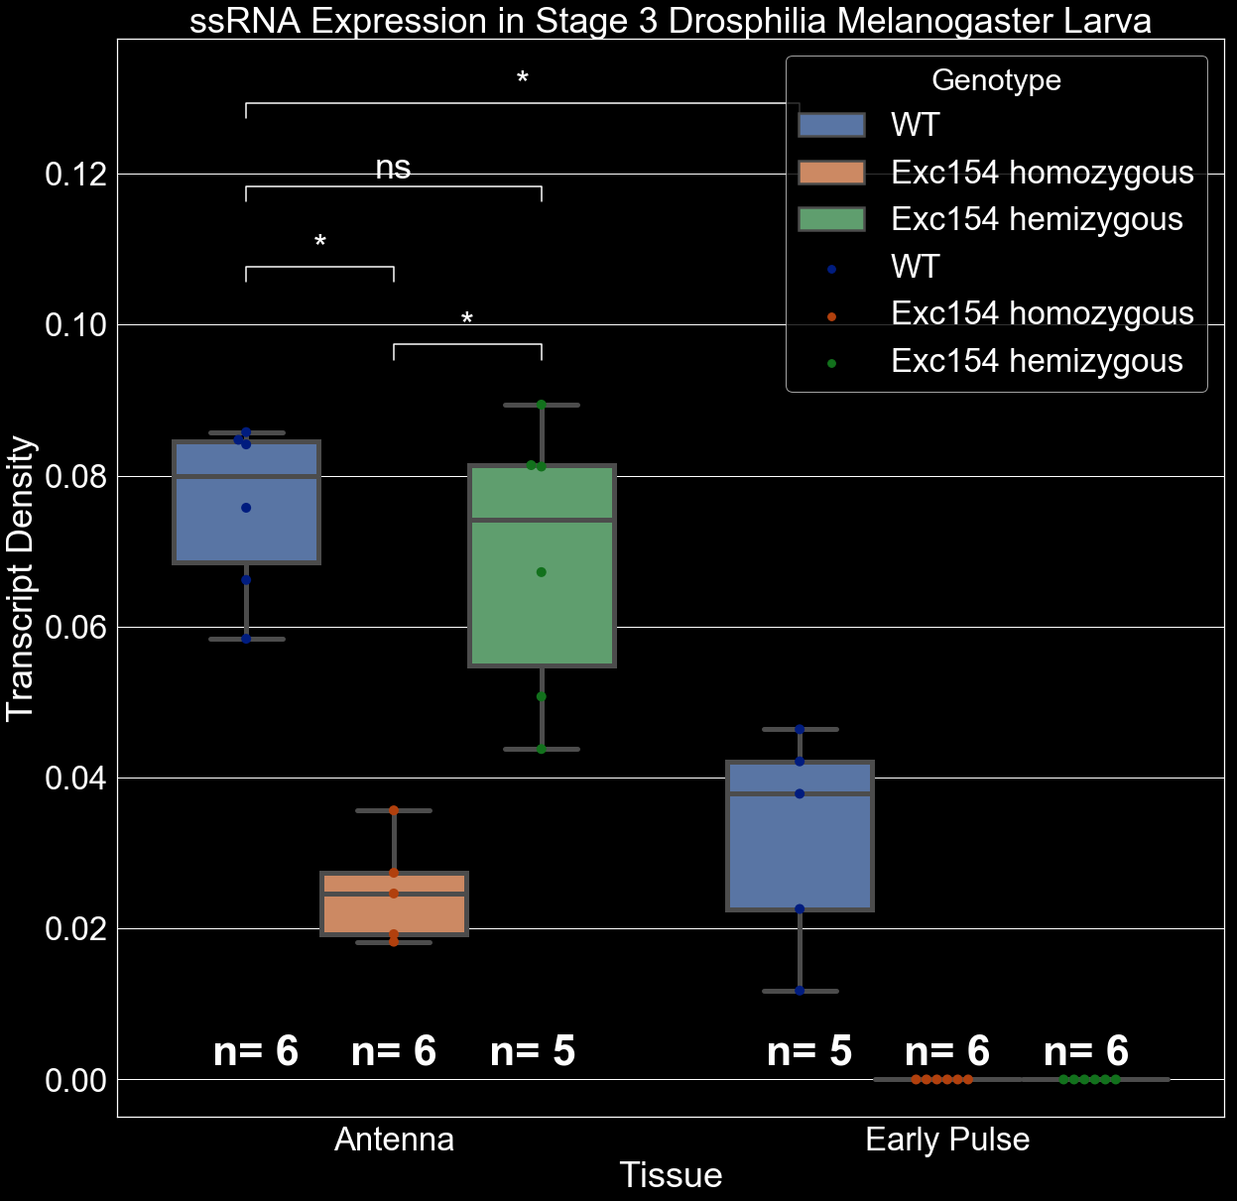

Slide 44
Transvectional Chromatin Compaction?

Slide 45
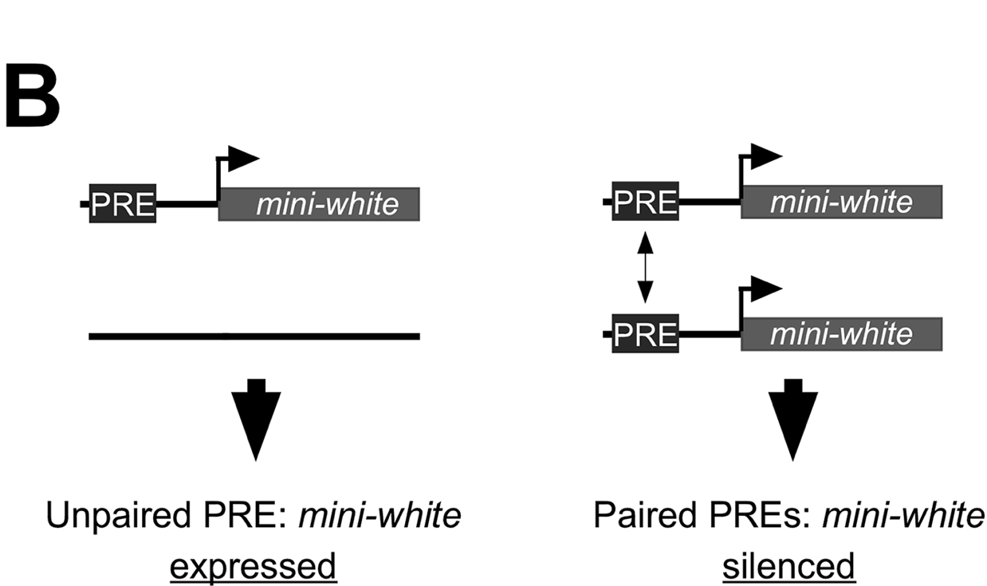
Pairing Sensitive Silencing: A Brief Summary
Two PRE elements enhance silencing activity of each other
A lot of pioneering work on this was done by Judith Kassis, but I also think that Kayla did work some work on pairing sensitive silencing as well
Tian, et al., 2019

Slide 46
What does the chromatin look like: DNA-FISH
50 kb Upstream
65 kb ss Locus
50 kb Downstream
d₁
Ss^{OFF}
d₂
Compact
d₂
d₁
Ss^{ON}
Open
Notes:
I have designed fluorescently labeled probes

Slide 47
50 kb Upstream
65 kb ss Locus
50 kb Downstream
d₁
Ss^{OFF}
d₂
Compact
d₂
d₁
Ss^{ON}
Open
Notes:
For the upstream and downstream regions of ss, as well as the DNA locus itself

Slide 48
50 kb Upstream
65 kb ss Locus
50 kb Downstream
d₁
Ss^{OFF}
d₂
Compact
d₂
d₁
Ss^{ON}
Open
Notes:
Spanning a total of 165 kb. Therefore, using fish, I can

Slide 49
50 kb Upstream
65 kb ss Locus
50 kb Downstream
d₁
ss^{OFF}
d₂
Compact
d₂
d₁
ss^{ON}
Open
Notes:
Identify how compact the locus is in every cell of the eye antenna disc.

Slide 50
50 kb Upstream
65 kb ss Locus
50 kb Downstream
d₁
ss^{OFF}
d₂
Compact
d₂
d₁
ss^{ON}
Open
Notes:
I can quantify these data as the distance from the center of one color punctae to the next.

Slide 51
50 kb Upstream
65 kb ss Locus
50 kb Downstream
d₁
ss^{OFF}
d₂
Compact
d₂
d₁
ss^{ON}
Open
Notes:
And we see that cells that express have a more open conformation

Slide 52
50 kb Upstream
65 kb ss Locus
50 kb Downstream
d₁
ss^{OFF}
d₂
Compact
Compaction (d_{T})
d_{T} = d₁ + d₂
d₂
d₁
ss^{ON}
Open
Notes:
And we calculate the total compaction as the sum of the distance between the spots

Slide 53
DNA FISH: Results

Slide 54

DNA FISH: Results

Slide 55
Exc154 Theorized Results
Exc154/Exc154:
Compact Chromatin because of PRE-driven repression

Slide 56
Exc154 Theorized Results
Exc154/def:
Open Chromatin because of silencer deletion

Slide 57
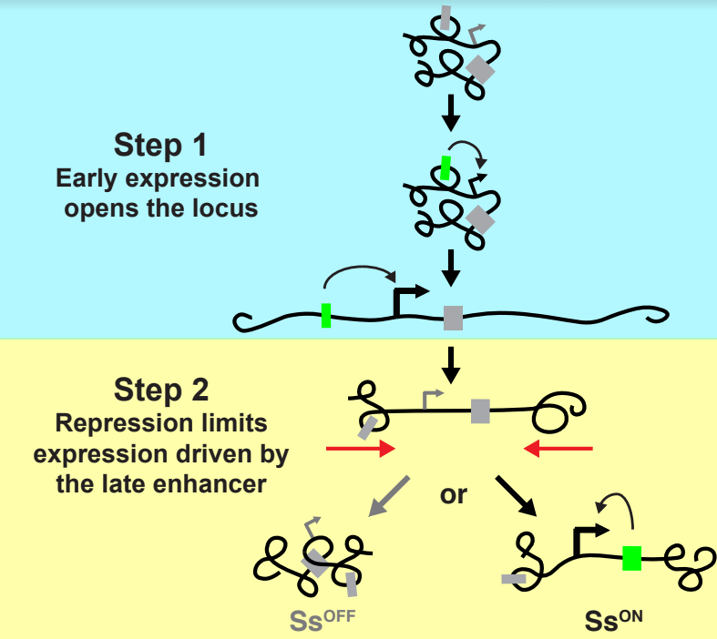
Two step model
Early Enhancer means that the locus cannot be opened by transcription in Exc154
Anderson, Voortman, et al, unpub

Slide 58
Two step model
Early Enhancer means that the locus cannot be opened by transcription in Exc154
But there is Rh4 expression in adult eyes and in the antenna: meaning spineless MUST still be expressed
Anderson, Voortman, et al, unpub

Slide 59
Two step model
Early Enhancer means that the locus cannot be opened by transcription in Exc154
But there is Rh4 expression in adult eyes and in the antenna: meaning spineless MUST still be expressed
In the hemizygote, spineless is constitutively open, meaning it can be transcribed late without early expression
Anderson, Voortman, et al, unpub

Slide 60
Two step model
Early Enhancer means that the locus cannot be opened by transcription in Exc154
But there is Rh4 expression in adult eyes and in the antenna: meaning spineless MUST still be expressed
In the homozygote, chromatin transvection/buttoning closes the locus
Anderson, Voortman, et al, unpub

Slide 61
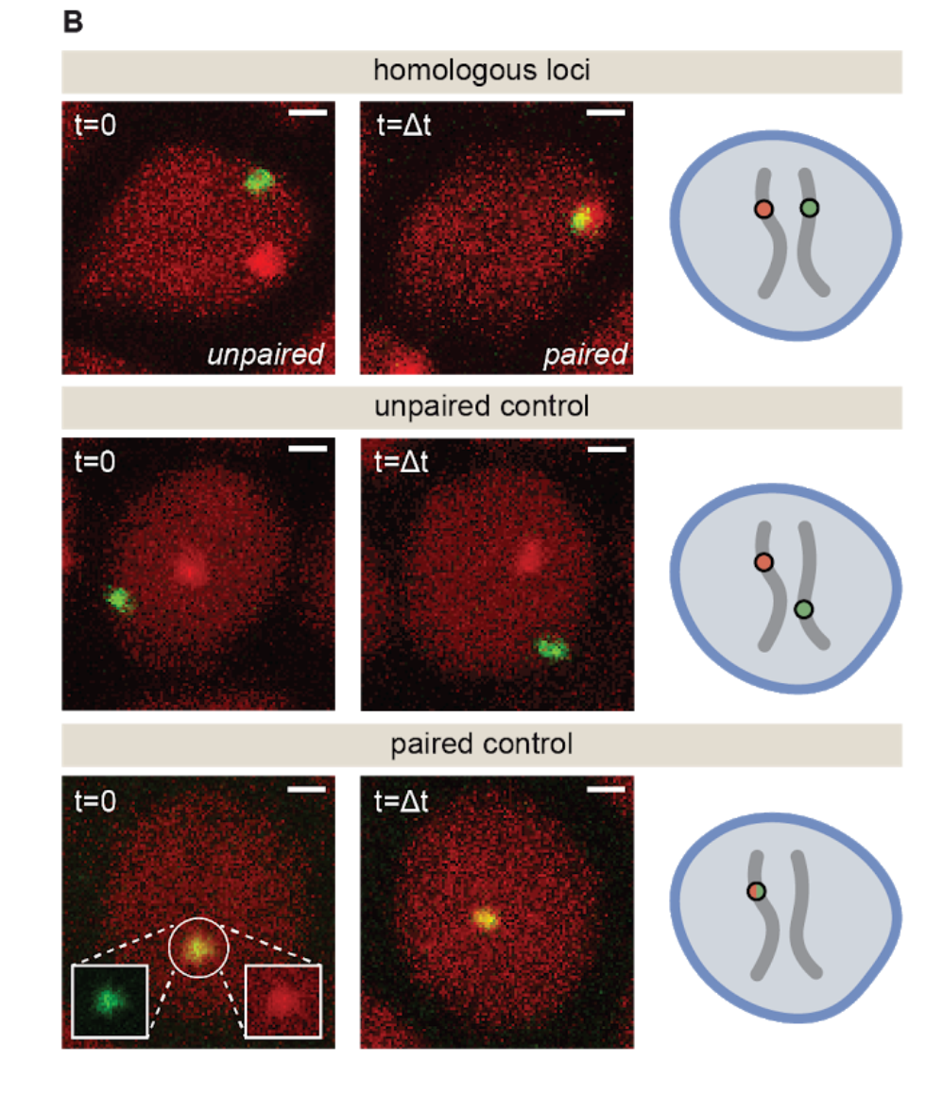
Future Directions
How important is location on the chromosome for transvectional silencing?
IDEA: Insert Exc154 spineless into a different chromosomal location on the deficiency chromosome.
From Garcia lab preprint. Also stuff Kayla worked on

Slide 62
Future Directions
How important is location on the chromosome for transvectional silencing?
IDEA: Insert Exc154 spineless into a different chromosomal location on the deficiency chromosome.
Does RH4 expression scale with the amount of deleted silencer?
IDEA: Serial CRISPR deletions of progressively larger portions of the silencer

Slide 63
Future Directions
How important is location on the chromosome for transvectional silencing?
IDEA: Insert Exc154 spineless into a different chromosomal location on the deficiency chromosome.
How important is intensity of Early Transcription anyway?
IDEA: hs inducible early transcription of spineless
Does RH4 expression scale with the amount of deleted silencer?
IDEA: Serial CRISPR deletions of progressively larger portions of the silencer

Slide 64
Future Directions
How important is location on the chromosome for transvectional silencing?
IDEA: Insert Exc154 spineless into a different chromosomal location on the deficiency chromosome.
How important is intensity of Early Transcription anyway?
IDEA: hs inducible early transcription of spineless
Pipe Dream Long Term idea: If we really understand how spineless induces photoreceptor cell fate, we should be able to engineer whatever desired Rh3/Rh4 ratio
Does RH4 expression scale with the amount of deleted silencer?
IDEA: Serial CRISPR deletions of progressively larger portions of the silencer

Slide 65
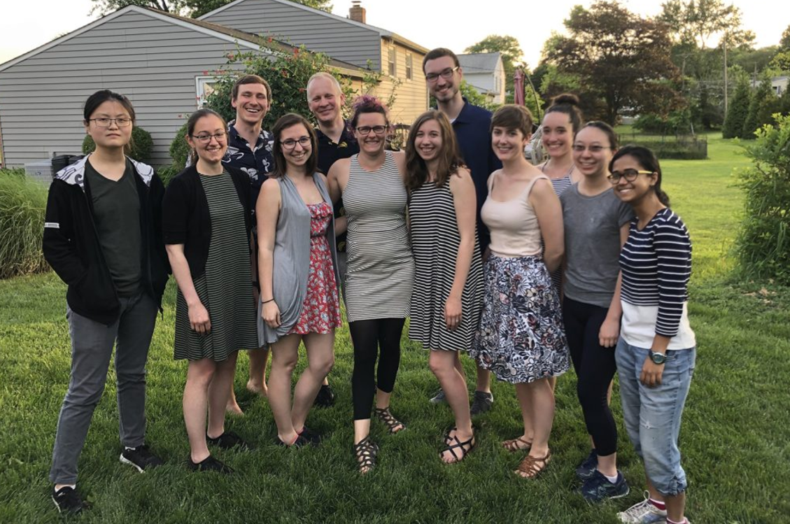


Grad Students
Luke Voortman
Sarah Hadyniak
Kasia Hussey
Christina
McNerney
Brian Guy
Simon Zhang
The Johnston Lab
Techs
Yaniris Molina
Alumni
Kayla Viets
Kiara Eldred
Caity Anderson
Sang Tran
Akin Sogunro
Mini Yuan
Postdocs
Jo Hagen
Ali Ordway
Undergrads
Adrienne Chen
Joyce Wang
Raphael
Chernoff
Jeong Han
Grace Gu
Collaborators
The Gregor
lab
Code Availability: https://github.com/ATiredVegan/Johnston_lab
Reagents
Jack Bateman

